Slide 1

Web Traffic Forecasting
Jun Yin
Springboard Data Science Career Track, Oct 2019
Capstone Project 1: Final Report

Slide 2
Table of Contents
Business Problem/Business Objective
Data Acquisition
Exploratory Data Analysis (EDA)
Missing Values Treatment
DataFrame Transforming
Selected Columns Exploration
Machine Learning Analysis
Data Preparation
Model Evaluation
Hyperparameter Tuning
Conclusions

Slide 3
Business Problem
Business Issue
Is there any apparent trends for web traffic?
How to predict the future traffic volume?
Business Objective
Build a machine learning model to predict.
Acquire the information to adjust either marketing or technique strategies.

Slide 4
Data Acquisition
6 datasets including one main dataset and five supplementary datasets.
Each row corresponds to a particular article and each column correspond to a particular date.
Data acquire from https://www.kaggle.com/c/web-traffic-time-series-forecasting

Slide 5
Data Acquisition
The information for all datasets listed below:
train_1 / train_2: two main datasets with approximately 145k time series. Each of these time series represent a number of daily views of a different Wikipedia article, starting from July 1st, 2015 up until December 31st,2016.
key_1/key_2 : mapping between the page names and the shortened ID column.
sample_1_submission/sample_2_submission: submission files showing the correct format.

Slide 6
Exploratory Data Analysis (EDA)
EDA finds trends, anomalies, patterns, or relationships within the data.
Missing Value Treatment
Fill in missing values with median
DataFrame Transformating
Meet the requirement by Prophet model
Keep two columns only: ds and y

Slide 7
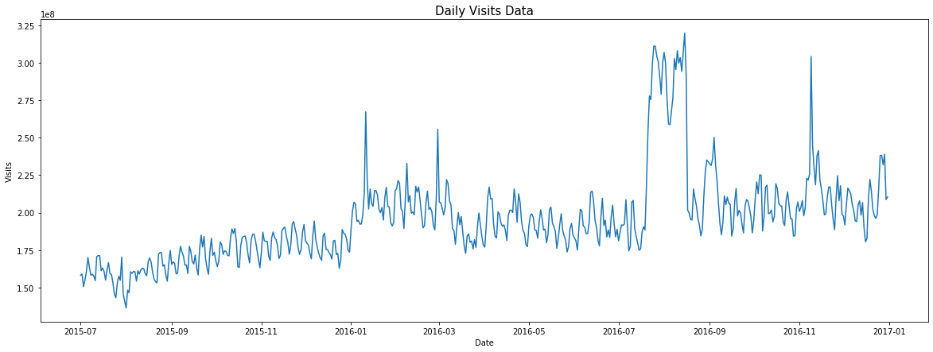
Exploratory Data Analysis (EDA)
Observe from “Daily Visit Data”
Huge spike around 2016-08, and several medium spikes during year 2016.

Slide 8
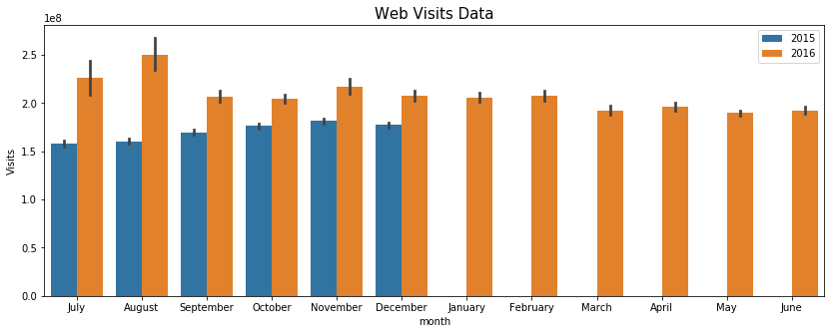
Exploratory Data Analysis (EDA)
Observe from “Web Visits Data Yearly Comparison”
Spikes showing up in July and August in 2016; while in the latter half of 2015, more traffic in November, 2015. The whole year of 2016 has more visits than 2015.

Slide 9
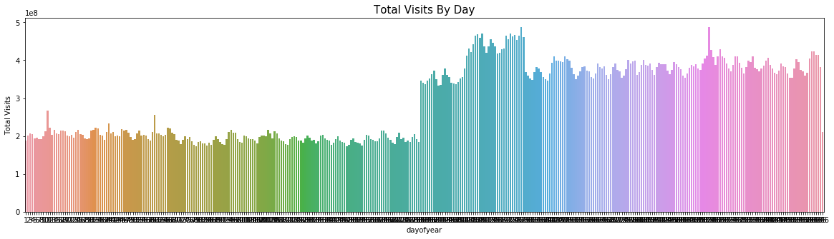
Exploratory Data Analysis (EDA)
Observe from “Daily Visits of Year”:
Higher plateau in year 2016 compared to year 2015 and more visits shown up in the middle of 2016.

Slide 10
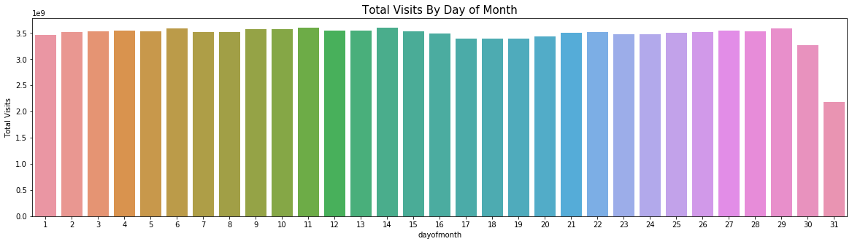
Exploratory Data Analysis (EDA)
Observe from “Day of Month Visits”
Slightly more visits at the beginning of each month, while less visits displayed at the end of month.

Slide 11
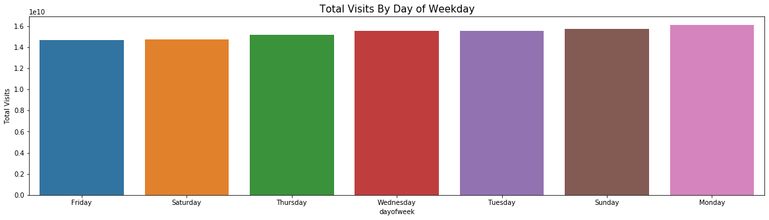
Exploratory Data Analysis (EDA)
Observe from “Weekday Visits”
Similar visits during a week. Monday is slightly higher than the rest.

Slide 12
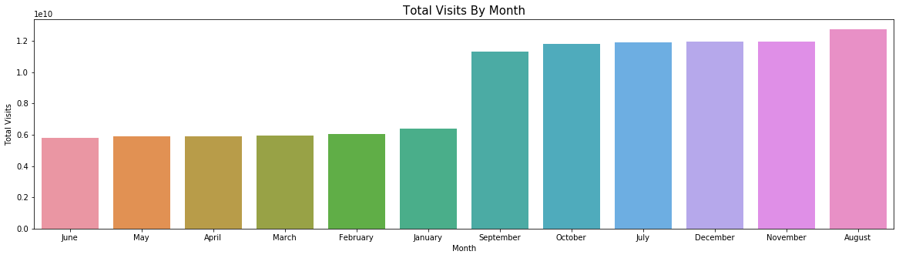
Exploratory Data Analysis (EDA)
Observe from “Monthly Visits”
August has the most visits; and the rest months of latter half year gain more visits compared to the first half year.

Slide 13
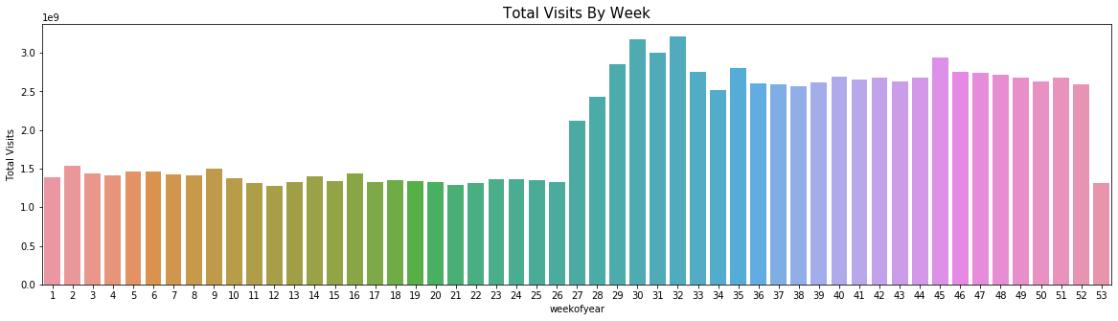
Exploratory Data Analysis (EDA)
Observe from “Week of Year Visits”
Latter half of year attracts more visits compared to the first half of the year.

Slide 14
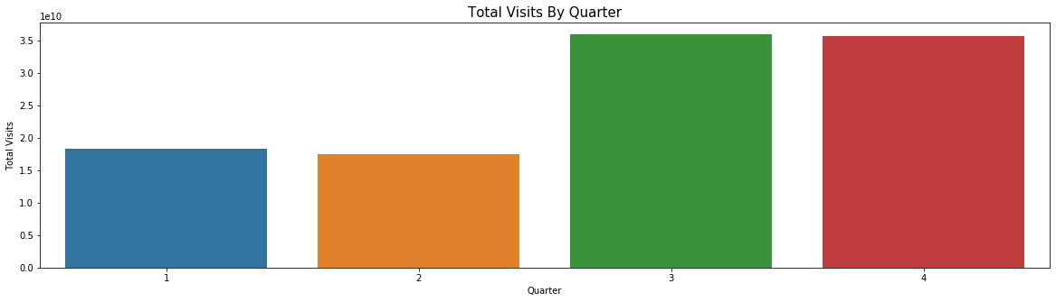
Exploratory Data Analysis (EDA)
Observe from “Quarter Visits”
More visits happened in quarter 3 and 4.

Slide 15
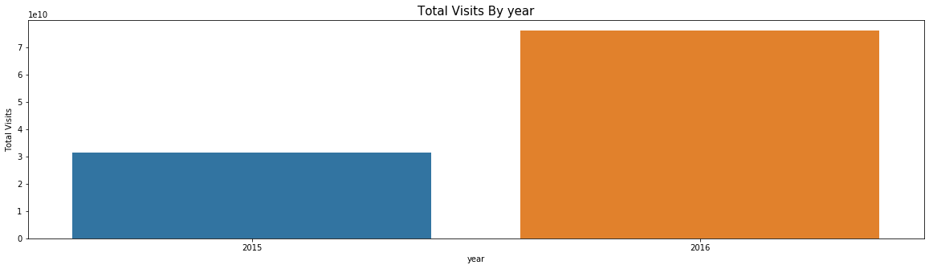
Exploratory Data Analysis (EDA)
Observe from “Yearly Visits”
Dramatic visits increasing in year 2016.

Slide 16
Machine Learning
Data Preparation:
Filling in missing values with median
Two columns are kept for the further evaluation, ‘ds’ representing date and ‘y’ representing visits.
Perform FB Prophet model for this project, hyperparameter tuning also applied.
Split data into two parts: 70% for training and 30% for testing.

Slide 17
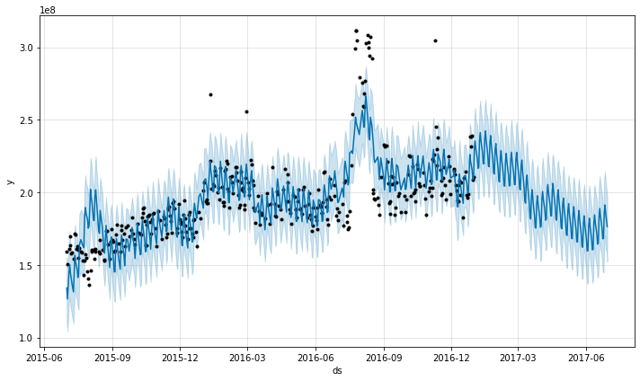
Machine Learning
Model Evaluation
rmse (root mean square error) value: 16764868.

Slide 18
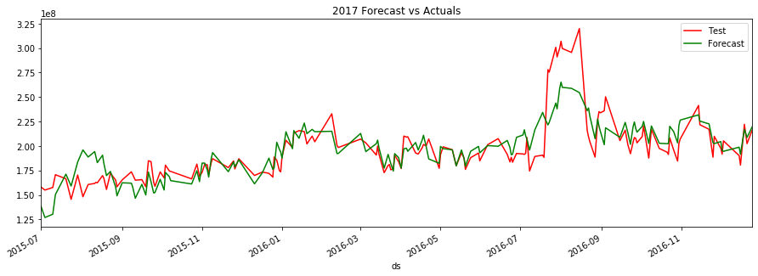
Machine Learning
Model Evaluation
Comparison between current data from July 1st 2015 to Dec 31st 2016 and prediction data
based on those shows similar trend.

Slide 19
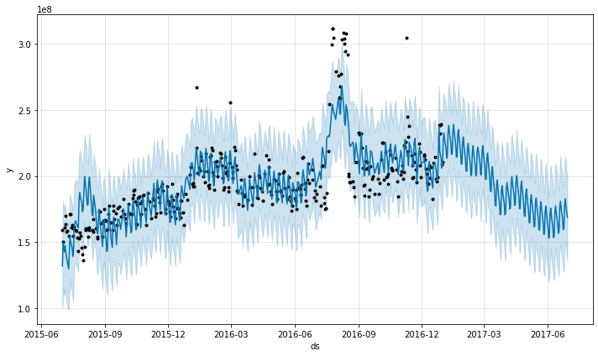
Machine Learning
Model Evaluation
rmse (root mean square error) value: 16400257.

Slide 20
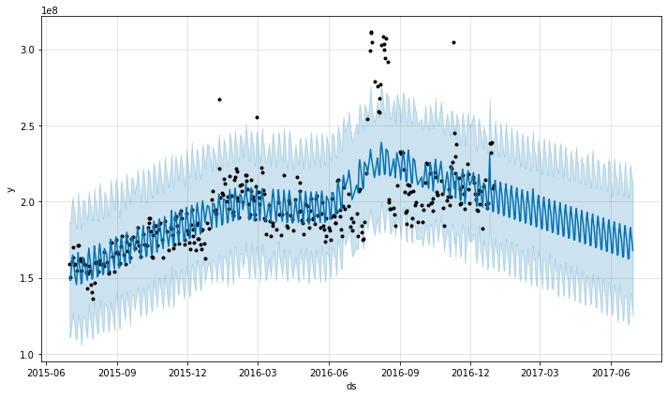
Machine Learning
Model Evaluation
rmse (root mean square error) value: 19477487.

Slide 21
Machine Learning
 | rmse | MAPE
Trial 1 | 16764868 | 39.6
Trial 2 | 16400257 | 38.0
Trial 3 | 19477487 | 25.1
Comparison of rmse and MAPE

Slide 22
Conclusions
Exploratory data analysis is performed and FB Prophet machine learning models is evaluated for time series analysis. Hyperparmeter tuning is applied to achieve the best parameters.
rmse (root mean square error) value is the evaluation criteria for prediction and MAPE (mean absolute percentage error) number is obtained to select the best parameter combination from hyperparameter. tuning.
The best model displays rmse value 16400257, compared to original rmse 16764868.
The machine learning models can be used for prediction of the future web traffic, which could help structure sites, highlight security problems or indicate a potential lack of bandwidth.

Slide 23
Thank you

